Slide 1

Open Data and Web Services (ODWS)
Final project
Group 3
Alice Laraspata, Claudio Morelli, Simon Danny Pettinella
2019/2020

Slide 2



What is the problem?
The central problem is ENTREPRENEURIAL ECONOMIC UNCERTAINTY

Slide 3
What is the need?
Correct ORIENTATION of the market dynamics
Can open data meet this need?
YES, databases are capable of providing information and data relating to this need

Slide 4
Primary and Specific target
The PRIMARY TARGET is to ASSIST the stakeholder while operating an entrepreneurial choice
The SPECIFIC TARGET is to create a tool that can detect ATTRACTIVENESS and COMPETITIVENESS among European countries, analyzing and comparing general and sectoral economic data

Slide 5
Primary and Specific objective
European Country 1
1
General economic parameters
2
Analysis of economic sectors
Agriculture
Transport
Automotive
Sustainability
Technology
R&D

Slide 6
Expected results
How can the web service help the entrepreneur to orientate himself?
It will support the entrepreneur to make the best choice of SECTOR in the European country where he intends to INVEST
Furthermore, the entrepreneur will be able to examine the DEVELOPMENT of a specific index in five years time within the same country

Slide 7
Activities facies
1. Ideation of the web services: What is the idea?
The web service will have to be able to POSITION the various European countries in a RANKING according to the general economic parameters; it will then have to be able to DEEPEN the competitiveness level in each specific market
The key performance of the entire web service is to be able to COMPARE European countries according to markets or market parameters, creating a ranking for EVERY NEED

Slide 8
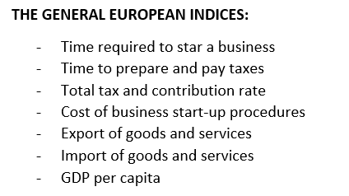
Activities facies
2. Identification of the parameters
FIRST STEP: to IDENTIFY the parameters that could provide the general economic picture of each European country.
In this regard, the GENERAL EUROPEAN INDICES as follows:

Slide 9
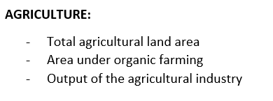
Activities facies
2. Identification of the parameters
SECOND STEP: to ANALISE the following SIX MACRO-SECTORS of each European countries, choosen on the bases of the highest levels of Italian turnover in recent years, with the rispective indices:
1

Slide 10
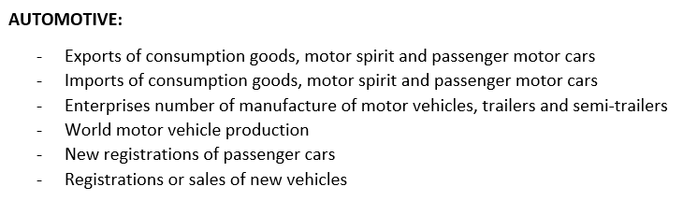
Activities facies
2. Identification of the parameters
2

Slide 11
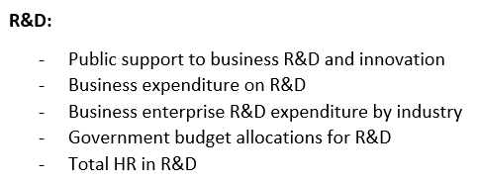
Activities facies
2. Identification of the parameters
3

Slide 12
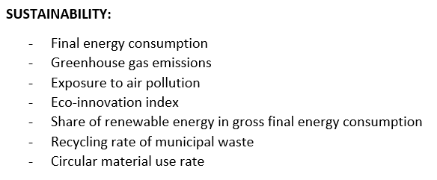
Activities facies
2. Identification of the parameters
4

Slide 13
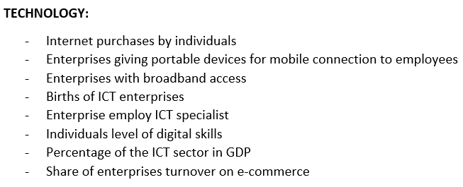
Activities facies
2. Identification of the parameters
5

Slide 14
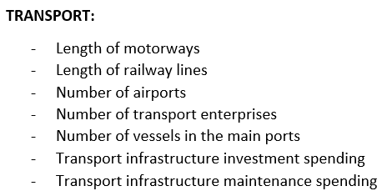
Activities facies
2. Identification of the parameters
6

Slide 15

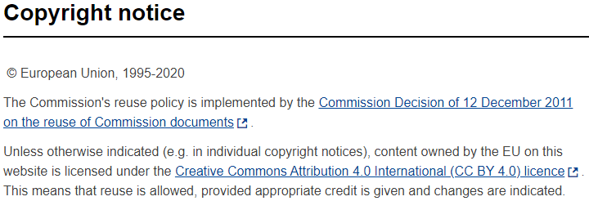
Activities facies
3. Data collection from the web
The final datasets used in order to collect data are: Eurostat, OECD, The World Bank and We Forum
1
https://ec.europa.eu/info/legal-notice_en

Slide 16
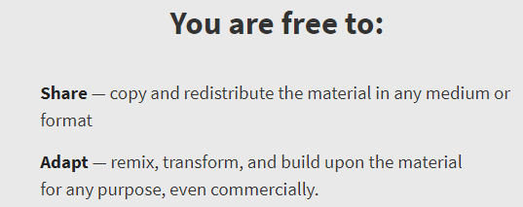
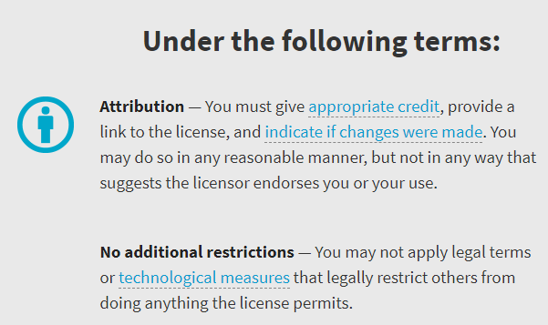
Activities facies
Creative Commons Attribution 4.0 International licence (CC BY 4.0)
https://creativecommons.org/licenses/by/4.0/

Slide 17

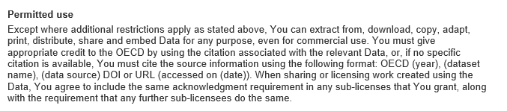
Activities facies
3. Data collection from the web
2
http://www.oecd.org/termsandconditions/

Slide 18

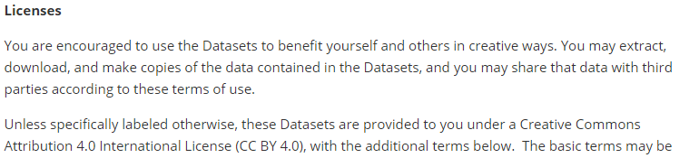
Activities facies
3. Data collection from the web
3
https://www.worldbank.org/en/about/legal/terms-of-use-for-datasets

Slide 19
Activities facies
Creative Commons Attribution 4.0 International licence (CC BY 4.0)
https://creativecommons.org/licenses/by/4.0/

Slide 20

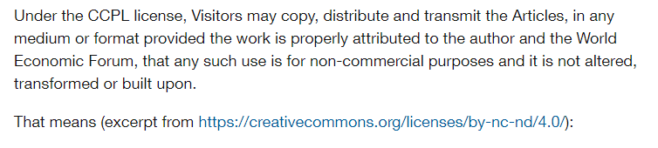
Activities facies
3. Data collection from the web
4
https://www.weforum.org/about/terms-of-use

Slide 21
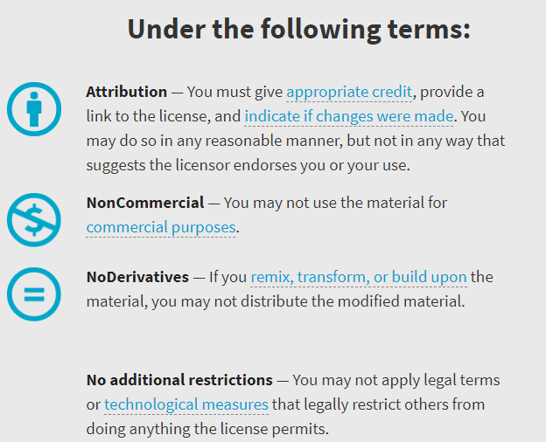
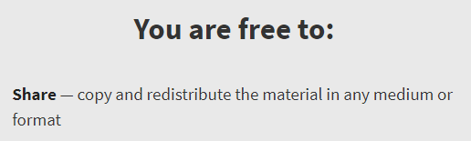
Activities facies
Creative Commons Attribution-NonCommercial-NoDerivatives 4.0 International licence (CC BY-NC-ND 4.0)
https://creativecommons.org/licenses/by-nc-nd/4.0/

Slide 22
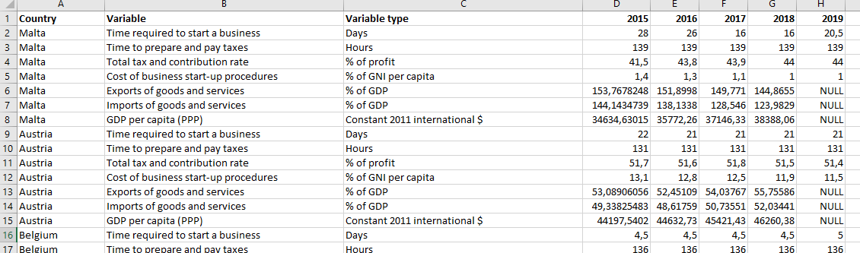
Activities facies
3. Cleaning and organization of the collected data
We created an excel file containing all the indices for each specific sector
This is the example of the ‘General European Data’

Slide 23
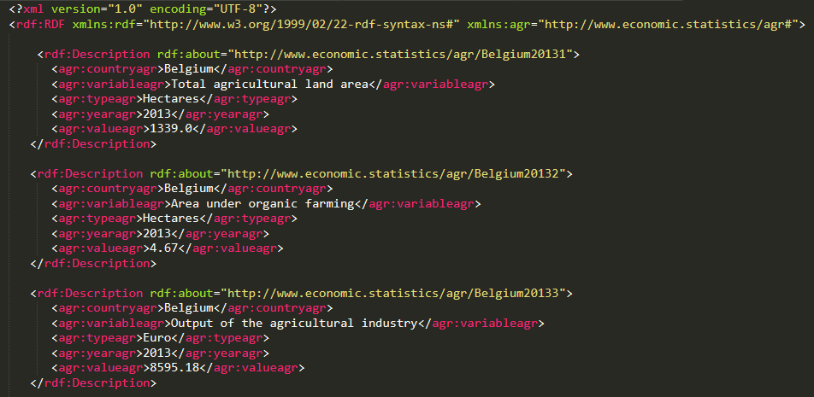
Activities facies
3. Cleaning and organization of the collected data
This is the relative RDF file for the ‘Agriculture’ sector.
All the RDF files have been created with the help of the ‘Open Refine’ tool

Slide 24
Activities facies
3. Cleaning and organization of the collected data
Data concern exclusively the twenty-seven European countries;
Data refer to the five last available years starting from year 2019 as the most recent year;
In case of no data for some of the five years, the missing data will be considered as NULL, identified with the ‘:’ symbol

Slide 25
Activities facies
4. Definition of the Maven project
1. The type of the adopted architecture for the realization of the project is REST (Representational State Transfer).
2. The web service dependency manager is Apache Maven.
Below the various steps that led us to the realization of the Maven project

Slide 26
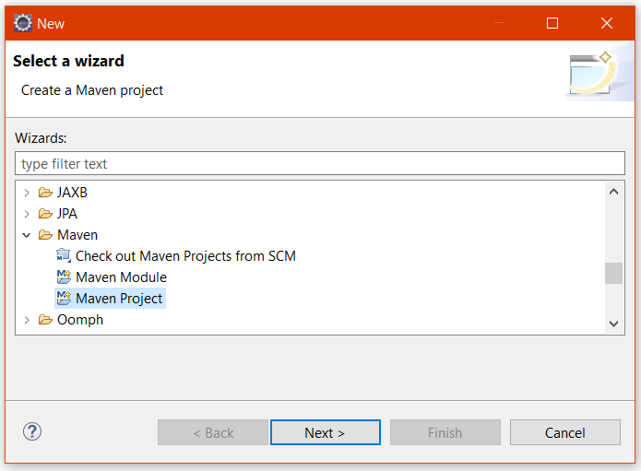
Activities facies
4. Definition of the Maven project
1. New Maven Project

Slide 27
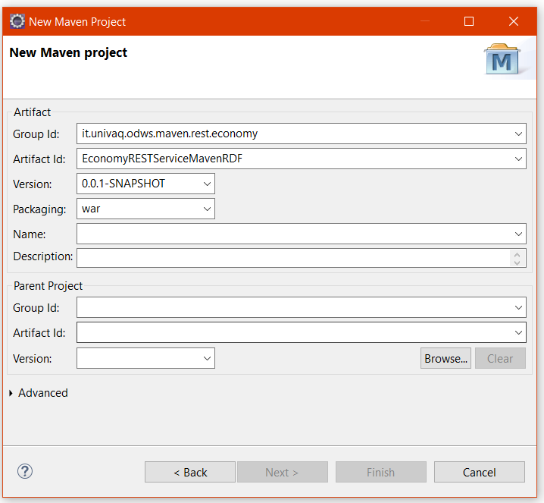
Activities facies
4. Definition of the Maven project

Slide 28
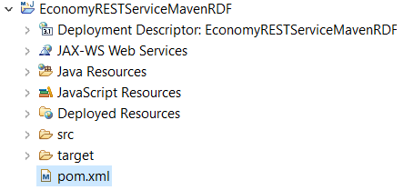
Activities facies
4. Definition of the Maven project
2. The structure of the project

Slide 29
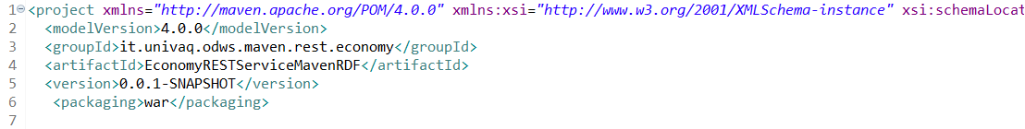
Activities facies
4. Definition of the Maven project
3. The configuration of the pom.xml file

Slide 30
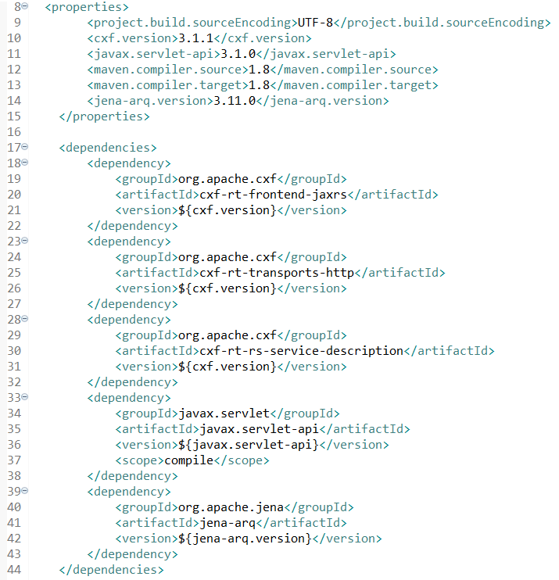
Activities facies
4. Definition of the Maven project

Slide 31
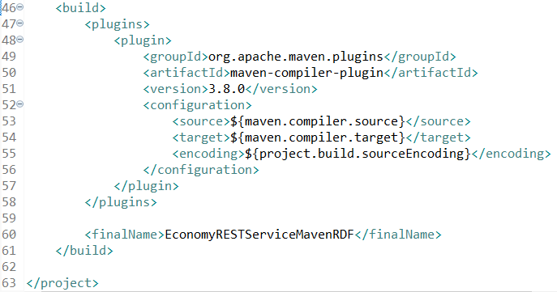
Activities facies
4. Definition of the Maven project

Slide 32
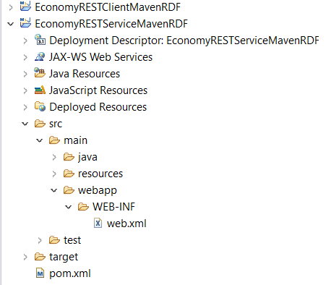
Activities facies
4. Definition of the Maven project
4. The creation of the web.xml file

Slide 33
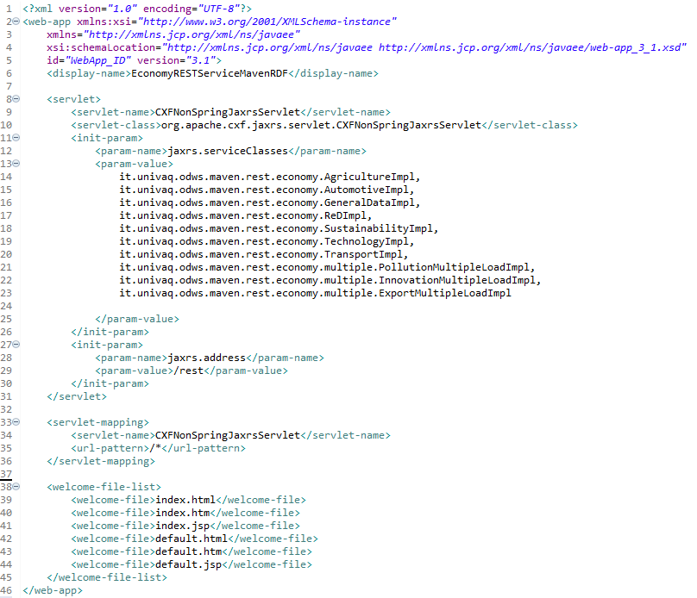
Activities facies

Slide 34
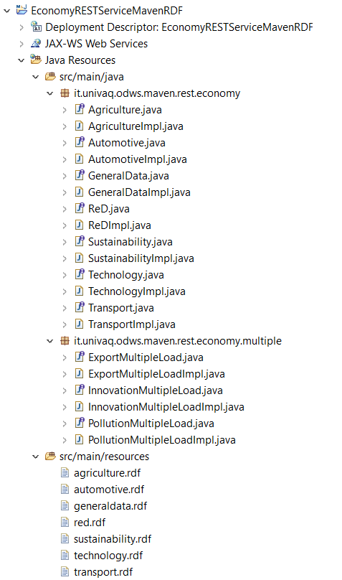
Activities facies
4. Definition of the Maven project
5. The creation of packages and the loading of the resources

Slide 35
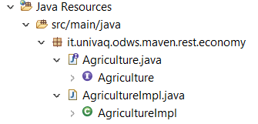
Activities facies
4. Definition of the Maven project
6. The creation of the interfaces and classes containing the related implementations of the methods

Slide 36
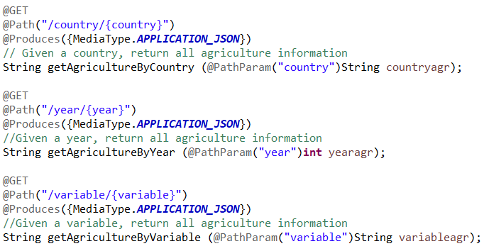
Activities facies
4. Definition of the Maven project
7. The definition of the methods
Let’s define queries according to three differently levels of difficulty:
Level 1

Slide 37
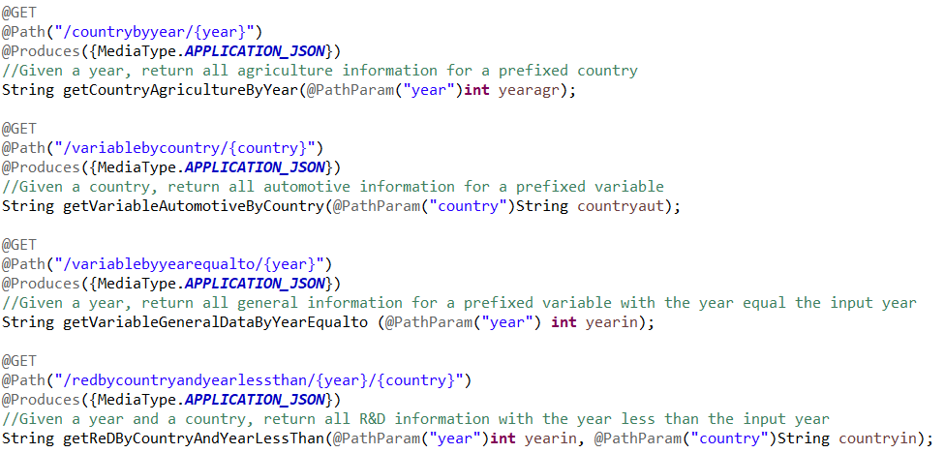
Activities facies
4. Definition of the Maven project
7. The definition of the methods
Level 2

Slide 38
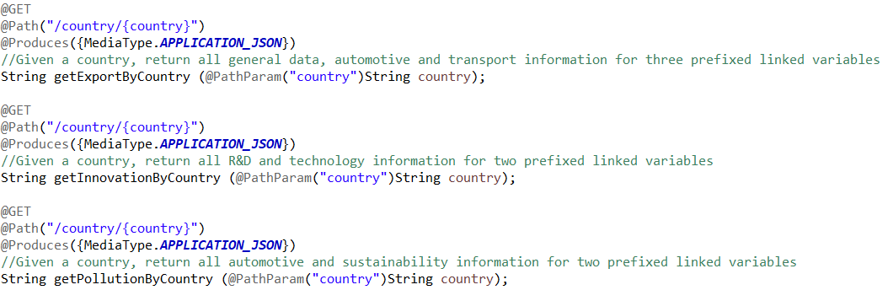
Activities facies
4. Definition of the Maven project
7. The definition of the methods
Level 3

Slide 39
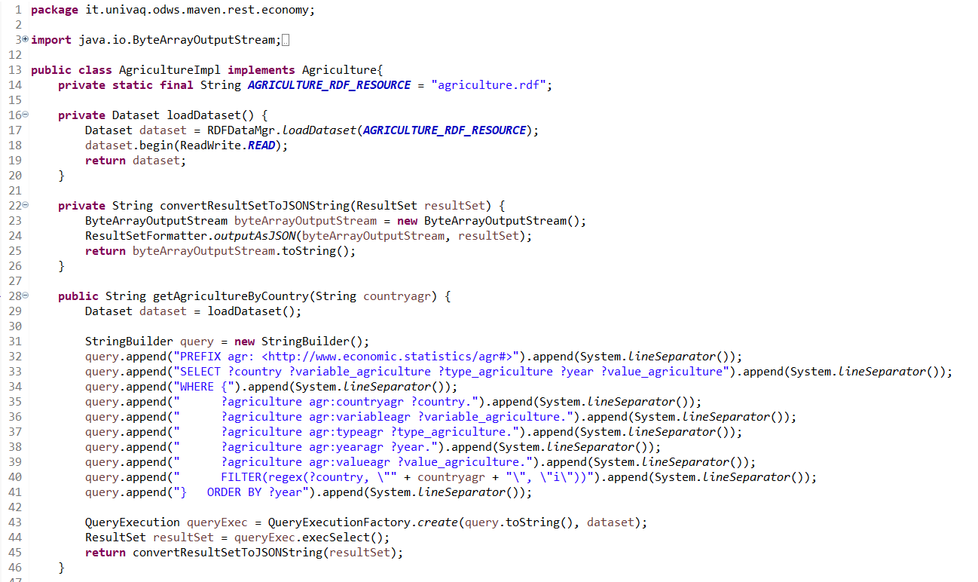
Activities facies
4. Definition of the Maven project
8. Implementation of the level 1 query

Slide 40
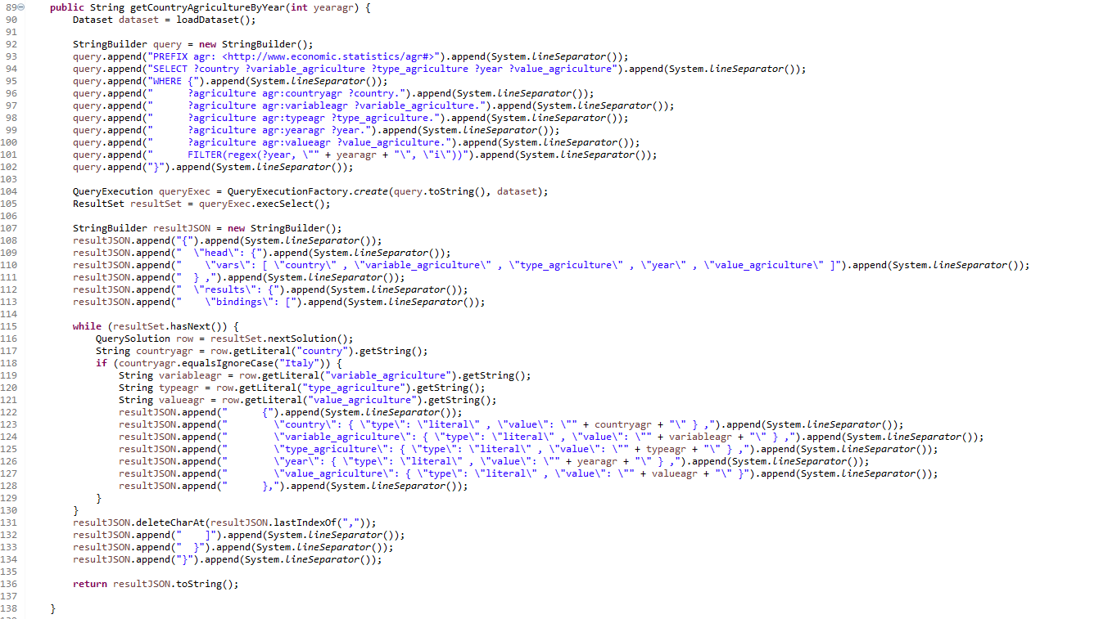
Activities facies
4. Definition of the Maven project
8. Implementation of the level 1 query

Slide 41
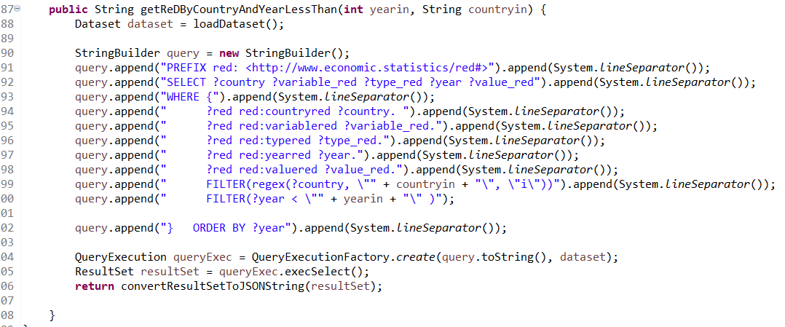
Activities facies
4. Definition of the Maven project
8. Implementation of the level 2 query

Slide 42
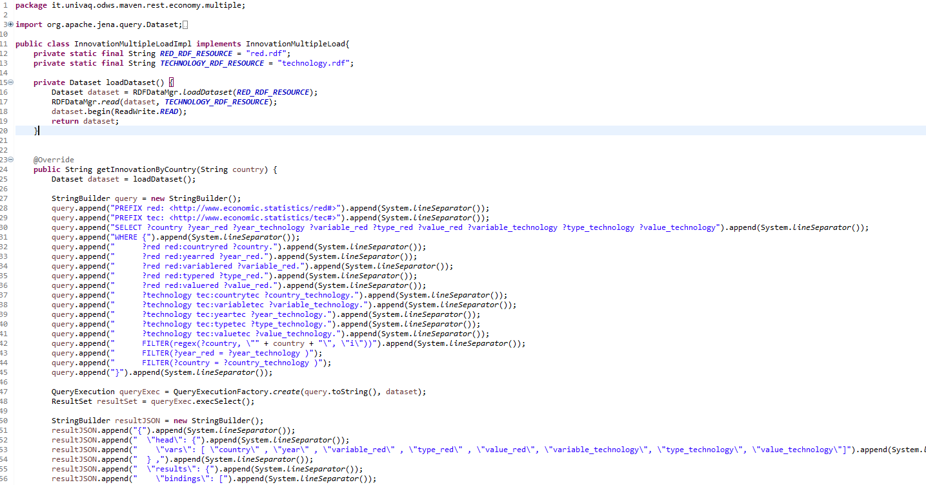
Activities facies
4. Definition of the Maven project
8. Implementation of the level 3 query

Slide 43
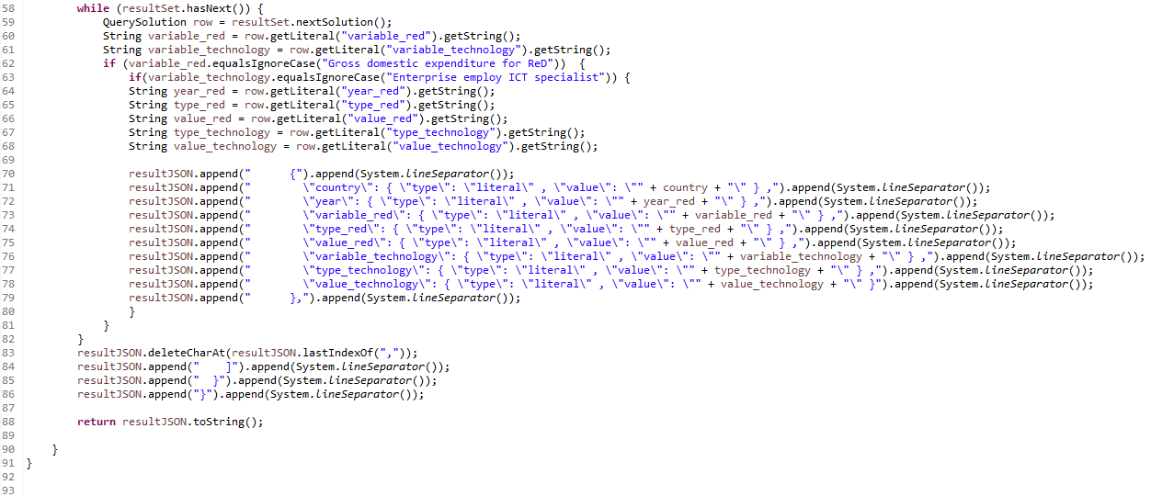
Activities facies

Slide 44
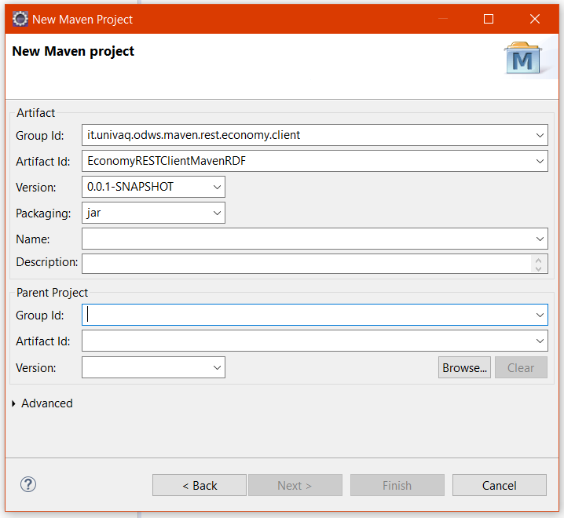
Activities facies
5. Definition of the Java Client
1. The creation of the Java Client

Slide 45
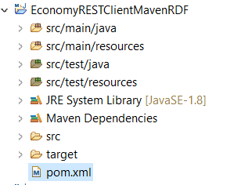
Activities facies
5. Definition of the Java Client
2. The structure of the Client

Slide 46
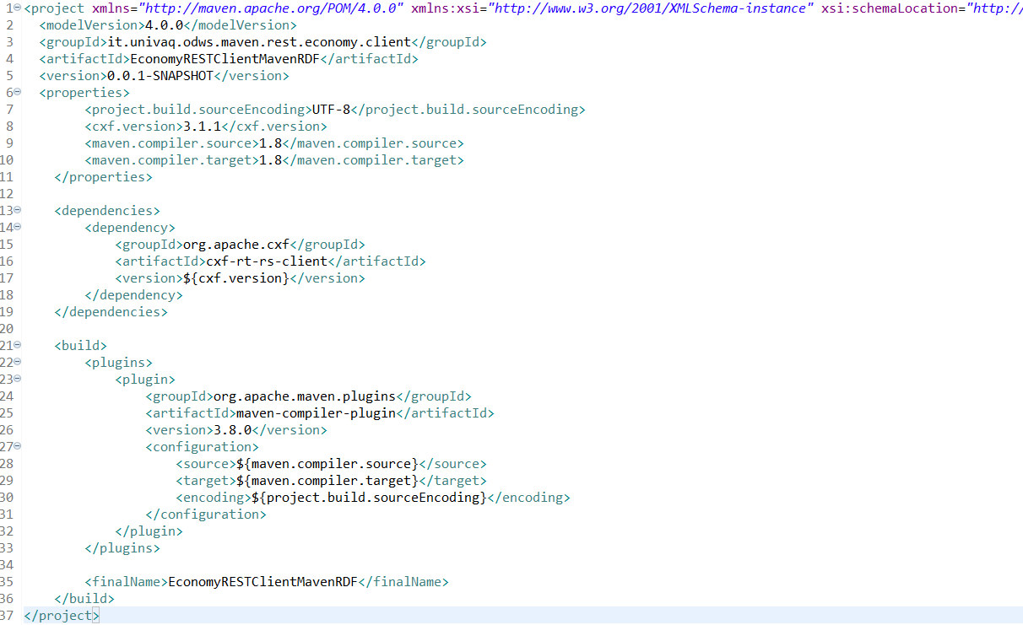
Activities facies
5. Definition of the Java Client
3. The configuration of the pom.xml file

Slide 47
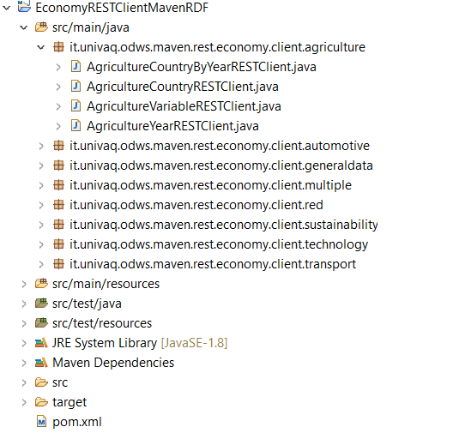
Activities facies
5. Definition of the Java Client
5. The creation of the packages and the related classes

Slide 48
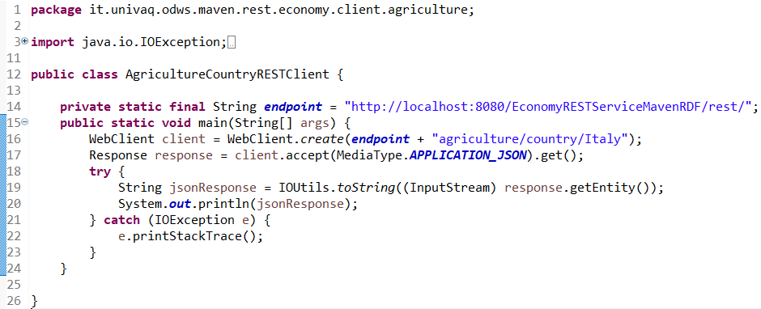
Activities facies
5. Definition of the Java Client
6. The Client implementation related to the level 1 query

Slide 49
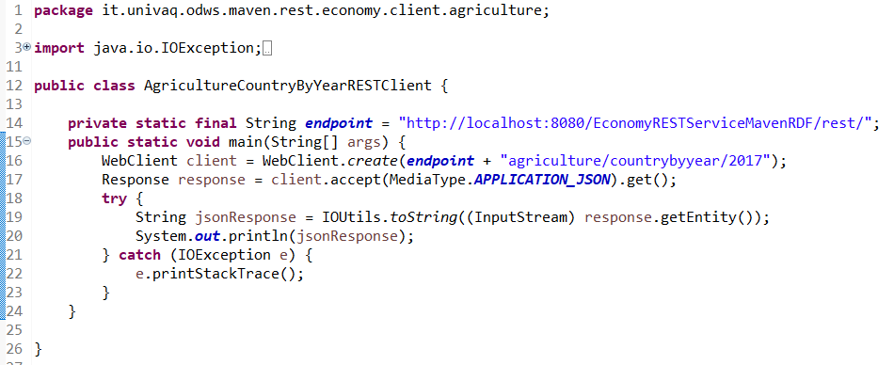
Activities facies
5. Definition of the Java Client
7. The Client implementation related to the level 2 query

Slide 50
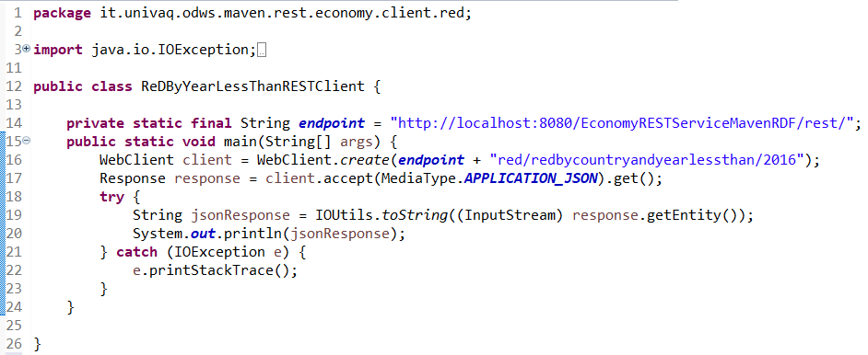
Activities facies
5. Definition of the Java Client
7. The Client implementation related to the level 2 query

Slide 51
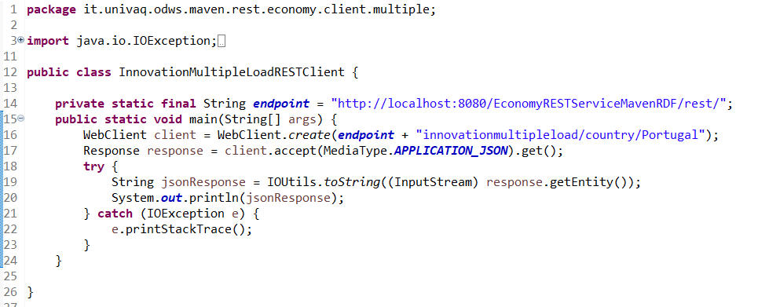
Activities facies
5. Definition of the Java Client
8. The Client implementation related to the level 3 query

Slide 52
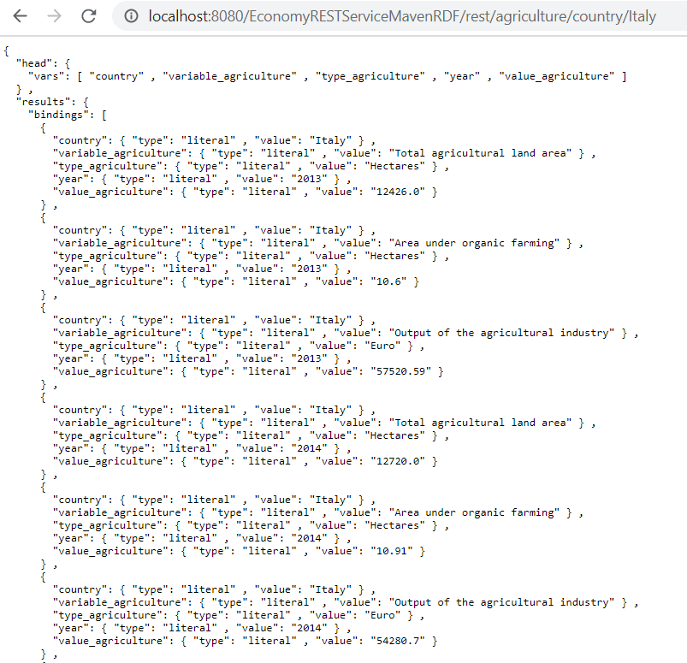
Activities facies
6. Output web service
1. Output browser

Slide 53
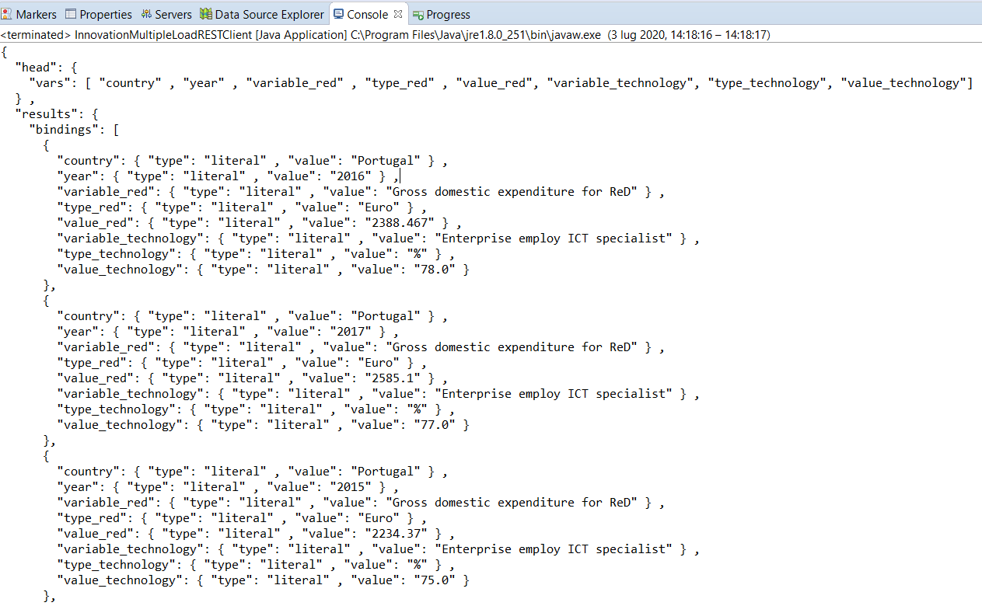
Activities facies
6. Output web service
2. Output client

Slide 54
Thanks for your attention
Alice Laraspata, Claudio Morelli, Simon Danny Pettinella
2019/2020

